Slide 1
GreenLedger
IC26-05-01 · SUSTAINABILITY & CLIMATE ACTION
Campus savings you can prove — not just claim.
Team Shinzen · Anup Batakurki · Het Balchandani · Kamaal
Dayananda Sagar University · Innovators Conclave 2026
Notes:
Open calmly, no slide-reading. “Every campus says it saved energy. Almost none can prove it. GreenLedger is the first campus tool that only counts savings it can prove.” Then click.

Slide 2
IC26-05-01 · GreenLedger
01 · PROBLEM STATEMENT
CAMPUS RESOURCE OPTIMISATION — THE BRIEF
Expected output
“Electricity, water and waste data are often tracked separately, making it difficult to identify avoidable consumption. Build a platform that combines periodic readings and action logs, highlights unusual changes and compares resource use against a baseline without overstating environmental benefits.”
Resource dashboard
Baseline / trend comparison
Action register
Exportable report
Labelled sample dataset
Domain: Sustainability & Climate Action · Suggested alignment: Ministry of Environment, Forest & Climate Change (MoEFCC)
Notes:
Read the highlighted words aloud: “without overstating environmental benefits.” Then say: “Every college can show a dashboard. The hard part — the part this problem really asks for — is proving that a saving is real. That is what we built.”

Slide 3
Campus savings are claimed, not proven
01 · WHY IT MATTERS
Tracked separately
25 of 55
Electricity, water and waste sit in different bills and registers.
Compared unfairly
real meter-months where nothing was done — and a simple before/after dashboard still reported a “saving”.
“This month vs last month” ignores weather, exams and holidays.
Over-claimed
Unproven savings are greenwashing — and money spent on actions that may not work.
Source: Concordia University open meter data (CC BY 4.0) — 6 real meters, placebo months in Mar 2019–Feb 2020
Notes:
“We took real university meter data and asked a simple question: in months where nothing was done, what does a normal dashboard say? It reported a saving 25 times out of 55. Nearly half. That is how greenwashing happens — not by lying, by comparing unfairly.” The brief literally says: compare against a baseline WITHOUT overstating benefits. That is our whole product.

Slide 4



One ledger that sees, acts — and proves
02 · PROPOSED SYSTEM
See
Act
Prove
Electricity, water, waste, e-waste and carbon in one dashboard — by department, on our campus map.
Recommendations sized from each building’s data, live room control from a camera and live weather, e-waste routing.
A ghost twin + placebo test checks every action. Only the low end of a proven saving is counted.
Notes:
“GreenLedger does three things. It SEES every resource in one place, by department. It ACTS — recommendations, a live room that switches fans and AC by itself, e-waste routing. And the part nobody else does: it PROVES. Every action is checked, and we only count what survives the test.”

Slide 5

How GreenLedger works — five steps
02 · PROPOSED SYSTEM
1
2
3
4
5
Collect
Clean
Learn normal
Prove
Show & act
Meter readings and bills, waste logs, device lists, a room camera, live weather.
Removes impossible jumps, stuck meters and half-recorded days.
A “ghost twin” of each building learns its normal use from weather and the calendar.
Each change is tested against normal ups and downs: verified or not proven.
Dashboard, campus map, live room control, e-waste plan, report.
Built with Python · LightGBM · YOLOv8 · ASHRAE 55 comfort model · FastAPI web app · runs in Google Colab
Notes:
Walk left to right in one breath each. “We collect what a campus already has — bills, meters, waste logs. We clean bad readings. We teach a ‘ghost twin’ what normal looks like for every building. When the campus makes a change, we prove whether it worked. And everything shows up on one dashboard, with a live room that switches itself.”

Slide 6
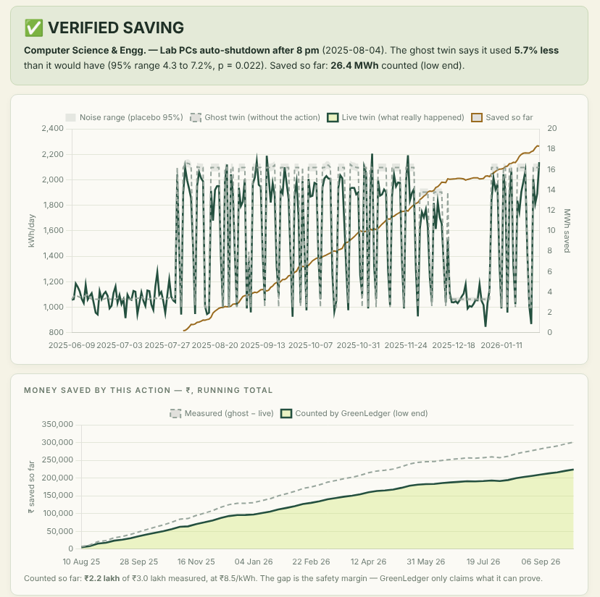
How a saving is proven
1
Build the ghost twin
A model learns the 12 months before the action, then is fed the real weather and calendar — what the building would have used without it.
2
Compare with the live twin
The live twin is the real meter. Saving = ghost − live.
3
Test it against noise
Placebo test: pretend the action happened on every week of the year before. Count it only if the real gap beats that noise (p ≤ 0.05) — and only its low end.
Notes:
Point at the chart. “The dashed line is the ghost twin — the building without the action, fed the real weather. The solid line is reality. The gap is the saving. But a gap can be noise, so we run a placebo test: we pretend the action happened on 45 other weeks when nothing happened and see how big fake savings get. We only count the saving if it beats the noise — and even then, only the bottom of the range.” Standards: IPMVP Option C, ASHRAE Guideline 14.

Slide 7
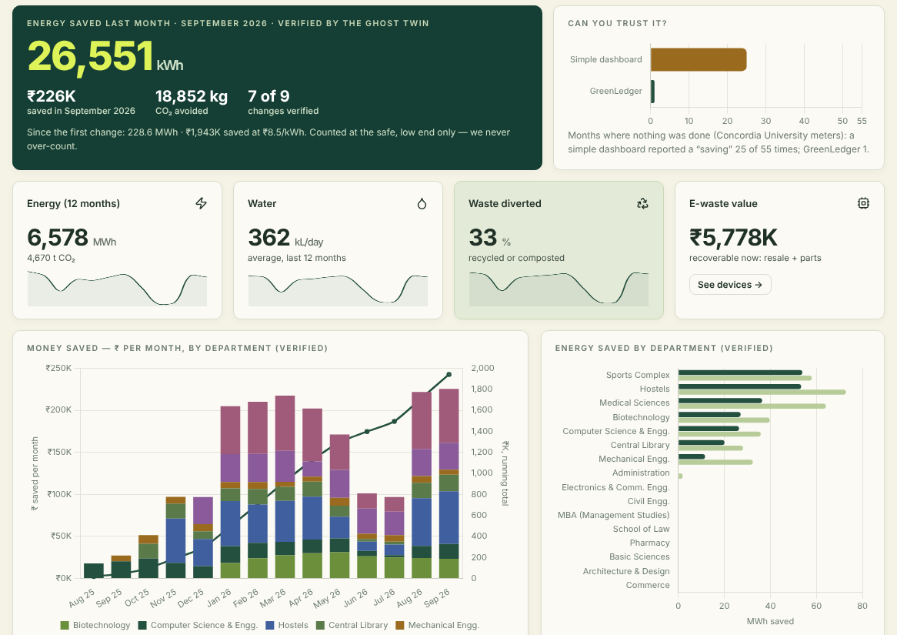
What the campus saved last month
02 · PROPOSED SYSTEM · DASHBOARD
26,551 kWh
September, verified
₹226K
saved that month
18.9 t
CO₂ avoided
16 departments, 7 of 9 changes verified. We count only the safe, low end — never more than the real saving.
Notes:
“One screen. Last month the campus saved 26,551 kWh — ₹226 thousand and almost 19 tonnes of CO₂ — and every unit of it is proven. We count the safe, low end on purpose.”

Slide 8
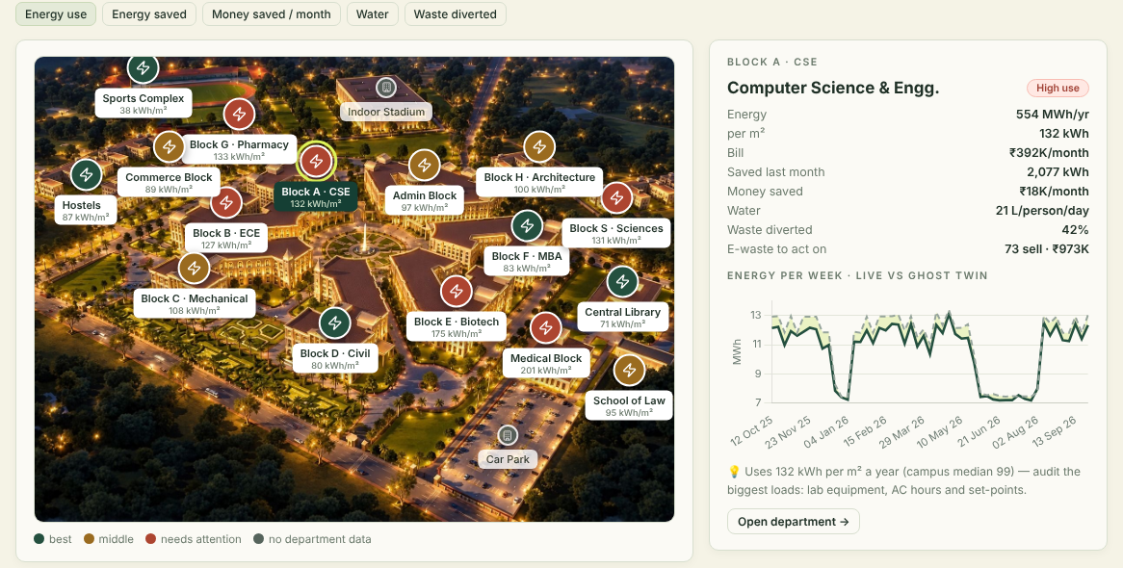
Our campus, block by block
Switch between energy use, energy saved, money saved, water and waste — every block re-colours. Click one for its numbers and a suggestion.
02 · PROPOSED SYSTEM · CAMPUS TWIN
Notes:
Click “Money saved”, then Block A · CSE. “All 16 departments — from Medical and Law to the Sports Complex — sit on their blocks of our campus. Red means needs attention — CSE uses 132 kWh per square metre against a campus median of 98, so the suggestion is to audit lab equipment and AC hours. One click opens the department.”

Slide 9
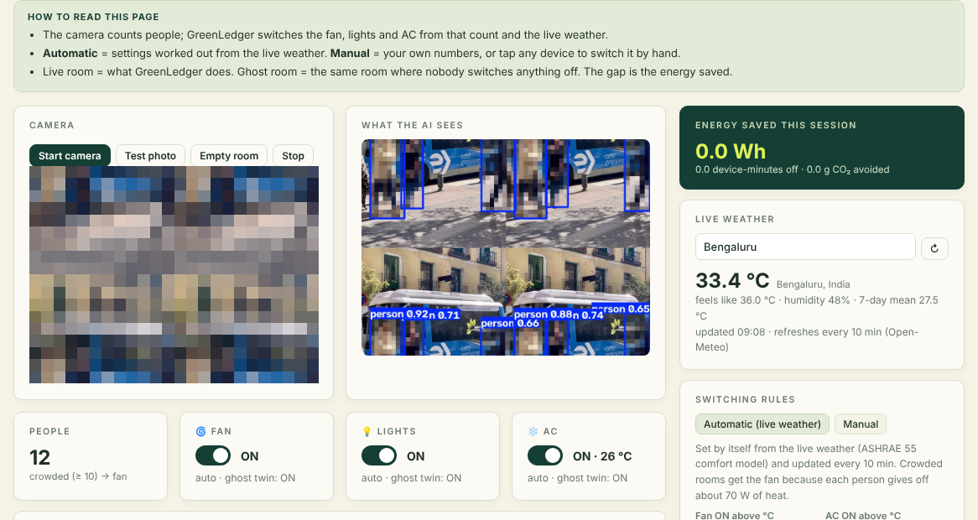
A room that switches itself
02 · PROPOSED SYSTEM · LIVE ROOM
Camera counts people (YOLOv8)
Live weather sets the rules (ASHRAE 55)
Crowded or warm → fan; too hot → AC, never below 24 °C
Empty → everything off
Manual mode and hand switches
People are pixelated; frames are never saved — only the count is kept.
Notes:
Run it live: upload a classroom photo → fan, lights, AC switch on with the reason shown; click “Empty room” → 30 s later everything is off and the live-vs-ghost room chart shows the saving. If the camera or network fails, play the 30-second screen recording — say “here’s a recording from earlier”. Mention privacy in one breath: pixelated, nothing stored.

Slide 10
Every device gets one decision — and a date
02 · PROPOSED SYSTEM · E-WASTE
Value recoverable now
499
723
₹5,778K
to sell second-hand now (≈ ₹2,385K) — waiting a year loses ≈ ₹508K
with reusable parts — RAM, SSDs, power supplies, compressors — pulled before recycling
from 2,803 devices across 16 departments
Working devices are sold a year before end of life, when they are still worth the most; the rest goes only to a CPCB-registered recycler (E-Waste Rules, 2022).
Upload your own asset register (CSV) and the same rules apply
Notes:
Quick: “Optimisation isn’t only energy. Our e-waste register gives every device one decision and a date: sell now — 499 devices, about ₹2,385 thousand, and waiting a year loses ₹508 thousand — repair, harvest parts, or a registered recycler.”

Slide 11
What GreenLedger found on our 16-department campus
03 · RESULTS
26,551 kWh
₹226K
18.9 t
energy saved last month (verified)
money saved last month
CO₂ avoided last month
7 of 9
6 of 16
2,803
changes verified — the other 2 correctly “not proven”
departments flagged “high use”, each with one fix
devices given an e-waste decision · ₹5,778K recoverable
Since the first change: 228.6 MWh and ₹1,943K saved · September 2026 · tariff ₹8.5/kWh · India grid 0.71 kg CO₂/kWh
Notes:
Point at the top row: “Last month alone the campus saved 26,551 units of electricity — about ₹226 thousand — and 19 tonnes of CO₂. Every one of those units is proven, not estimated.” Bottom row: “Seven of nine changes were verified; two were honestly rejected — one of them was awareness posters, which did nothing. Six departments are flagged with a fix, and every one of 2,803 devices has a plan.”

Slide 12
We tested the method before trusting it
03 · RESULTS · CAN YOU TRUST IT?
REAL METERS · PLACEBO MONTHS
TEST CAMPUS · KNOWN TRUTH
REAL EVENT · GROUND TRUTH
9 / 9
3 / 3
1 / 55
actions where the true effect fell inside our 95% range — and the count never exceeded the truth.
electricity meters where the COVID-19 campus closure is detected and verified — a test, never counted as a saving.
false savings certified by GreenLedger — against 25 / 55 for a simple dashboard.
Real meters: Concordia University open data (CC BY 4.0). Test campus: 16 departments where the true effect of every change is known.
Notes:
This is the slide that wins. “We didn’t just build it, we tested it three ways. On real meters, in months where nothing happened, a simple dashboard claimed savings 25 times; GreenLedger once. On our test campus, where we KNOW the true effect, the truth landed inside our range 9 out of 9 times, and we never counted more than the truth — even the ‘awareness posters’ action with zero effect was correctly rejected. And on a real event we know happened — the COVID closure — all 3 electricity meters show it.” If asked: the department data is our campus model, where the true effect is known — that is how accuracy is measured.

Slide 13




Everyone on campus gets something
04 · HOW IT HELPS
Facilities office
Management & finance
Sees exactly where energy and water are wasted, and which fix really worked.
Proven rupees saved every month — spend the budget on what works.
Students & staff
Environment & accreditation
Comfortable rooms that adjust themselves; no fans or AC running in empty rooms.
Honest CO₂ numbers and a verified report for green and energy audits (e.g., NAAC).
Notes:
One sentence per box, looking at the judges, not the slide. Close with: “It starts from the bills every campus already has — no new hardware needed to begin.”

Slide 14
Why GreenLedger beats a normal dashboard
05 · ADVANTAGES
What matters | Normal dashboard | GreenLedger
Fair comparison | This month vs last month | Adjusts for weather, exams, holidays
Proof that a saving is real | None | Placebo test + safe low end
False savings in normal months | 25 of 55 | 1 of 55
Electricity, water, waste, e-waste | Separate sheets | One place, per department, on a map
Takes action | Only shows numbers | Room switches fan, lights, AC itself
Privacy | — | People blurred, no images saved
Cost to start | New meters | Existing bills · open-source
Notes:
Pick only three rows aloud: fair comparison, proof, and 1 of 55 vs 25 of 55. “A normal dashboard tells you what you hope to hear. GreenLedger tells you what is true.”

Slide 15
Four reasons a campus can start tomorrow
05 · BENEFITS
1
Low cost
2
No new hardware
Open-source software on a computer the campus already has. It starts from the monthly bills — no new meters to begin.
Counts people with the classroom’s existing CCTV or webcam. Real switching just plugs into a standard smart plug when you’re ready.
3
Real savings
4
Automated
Every saving is proven against a ghost twin and counted at the safe, low end — 26,551 kWh and ₹226K last month.
Rooms switch fan, lights and AC by themselves; weather updates every 10 min; every change is checked; the report is one click.
Notes:
Count them on your fingers. “One: low cost — open-source, runs on a PC you already have, starts from your bills. Two: no new hardware — it uses the cameras already in our classrooms. Three: real savings — proven, not estimated: 26,551 units and two lakh twenty-six thousand rupees last month. Four: automated — the room runs itself and every change is checked without anyone doing the maths.” If asked about switching real devices: a standard smart plug, only when the campus wants it; until then it shows exactly what would switch.

Slide 16
Every expected output is in the app
BRIEF COVERAGE · EVERY EXPECTED OUTPUT
The brief asks for | GreenLedger
Resource dashboard | Energy, water, waste, e-waste, carbon — by department and on the campus map
Baseline / trend comparison | Ghost twin: weather- and calendar-adjusted baseline from the 12 months before
Highlight unusual changes | Alerts, discoveries and “fix now” items; the COVID closure is caught on real meters
Action register | Every action: verdict, 95% range, p-value, energy and ₹ counted
Without overstating benefits | Placebo test + low-end counting · 1/55 false savings vs 25/55
Exportable report | HTML report + CSV ledgers, one click
Labelled sample dataset | ZIP: real/ + simulated/ folders, a label on every row, data dictionary
Help and safety | Home page and Support & Info tab — in plain words
Notes:
Don’t read the table. One line: “Everything the brief asks for is in the app — start from the Home page; Support & Info explains every word.” Then go to the close.

Slide 17
We count only
what we can prove.
26,551 kWh
1 / 55
9 / 9
saved last month
false savings (vs 25)
truth inside our range
GreenLedger · Team Shinzen · Thank you
Notes:
Slow down. “Most tools tell you what you want to hear. GreenLedger tells you what you can prove. Thank you.” Stop talking; wait for questions. Leave the app on its Home page.

Slide 18
The 5-minute pitch, step by step
BACKUP · RUN OF SHOW
Time | Screen | Do and say
0:00 | Cover · Problem statement | Read the highlighted words: “without overstating benefits”.
0:30 | Why it matters | 25 of 55 normal months, a normal dashboard claimed a saving.
1:00 | Proposed system | See · act · prove, then the five steps, then ghost vs live.
2:00 | Live app | Dashboard → campus twin → live room (test photo, then empty room).
3:15 | Results | 26,551 kWh and ₹226K last month · 9 of 9 · 1 of 55 · 3 of 3.
4:00 | Helps · Advantages · Benefits | One line per group; three table rows; count the four benefits.
4:40 | Close | “We count only what we can prove. Thank you.” App on Home.
Notes:
Only 3 minutes? Skip the five-steps slide, the e-waste slide and the brief table. Before going on stage: run every notebook cell, open the app, load each tab once (warms the charts), open the Live Room tab and allow the camera, keep the screen recording on the desktop, and check the public link on a phone using mobile data.

Slide 19
Judge questions — data and method
If they ask… | Answer
Is the department data real? | It is our campus model: no Indian campus publishes department meters, so we built one where the true effect is known — that is how accuracy is measured.
Why Concordia, not DSU? | Open hourly meters plus waste invoices (CC BY 4.0). Our pilot swaps in DSU’s bills within 4 months.
Isn’t the ghost twin just a baseline? | A baseline adjusted for real weather, weekdays, holidays and season; the model is chosen per meter and gated by ASHRAE Guideline 14.
What stops fake savings? | The placebo test (p ≤ 0.05) and counting only the low end. Result: 1 false saving in 55 real months vs 25.
Did any real action get verified? | We refused to invent one — that is greenwashing. COVID proves detection on real meters; the register is ready for the first real action.
Notes:
Answer in one breath, then stop. If pushed on the campus model: “We know the true effect there, and the truth landed inside our range 9 out of 9 times. On real data we can’t know the truth — that’s exactly why the simulation exists.”

Slide 20
Judge questions — safety, cost, scale
If they ask… | Answer
Is the camera a privacy risk? | Frames are analysed in memory, never saved; only the count is kept. People are pixelated; no face recognition.
Does it switch real devices? | Via a certified smart plug or Home Assistant. Virtual by default; every device has a manual override.
Why is the AC set so warm? | ASHRAE 55 comfort-neutral for this week’s weather, never below BEE’s 24 °C default, with the fan on.
What does it cost to start? | Software is open-source Python; it starts from the monthly bills a campus already has. Sub-meters are optional.
Two actions at once? | Marked “confounded” — nothing is counted for either until they can be separated.
Where does ₹8.5/kWh come from? | An assumption set in the notebook (cell 13b) — replace it with the tariff on the electricity bill.
Notes:
If a question isn’t here: say what you know, then “that’s in our stated limitations” if it is. Never guess a number.

